Slide 1
Regional Webinar 2021
At the forefront of Acute Coronary Syndrome management in ED
High Sensitivity Troponin, APAC Perspectives and Evidence Review
Elanor Maria Lopez
Medical and Scientific Affairs, APAC

Slide 2
Program Overview
DATE: 8th April 2021 TIME: 1200-1300 SGT (60 min session)
TIME | DURATION | TOPIC | MODERATOR / SPEAKERS
1200-1205 | 5min | Welcome and Introduction | Dr Lee Chien-Chang (Associate Professor of Emergency Medicine at the National Taiwan University, Taipei, Taiwan.)
SESSION I
1205-1220 | 15min | hs Tn 0h/1h algorithm in ED-New Evidence Updates | Dr Lee Chien-Chang
1220-1235 | 15min | High-Sensitivity Troponin in Clinical Practice: Successful implementation and ESC 2020 guideline updates | Dr Cynthia Papendick (AU) (Staff Specialist Emergency Department Royal Adelaide Hospital, Australia)
1235-1250 | 15min | How to differentiate myocardial injury and infarction in cases of Sepsis, AMI, Renal Failure in the ED. | Dr Lee Chien-Chang (TW)
SESSION II
1250-1300 | 10min | Discussion/ Q&A | Dr Lee Chien-Chang (TW) Dr Cynthia Papendick (AU)

Slide 3
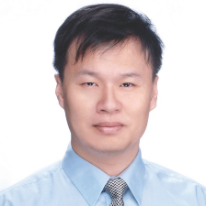
Dr Lee Chien-Chang , MD, MS, ScD.
Dr Lee Chien-Chang, MD, MS, ScD is an Associate Professor of Emergency Medicine at the National Taiwan University, Taipei, Taiwan. Dr. Lee is a prolific researcher who published more than 130 peer reviewed scientific publications and obtained more than 3900 citations. His works are usually published in prestigious journals such as JAMA internal medicine, Annals of Emergency Medicine, Critical Care Medicine, Resuscitation, Thorax, Chest, British Journal of Surgery, British Journal of Anesthesiology, and Clinical Microbiology and Infectious Disease. Currently, Dr. Lee is leading a multidisciplinary data science team to build a knowledge generation system that combine advanced statistics and informatics to realize the unbiased causal analysis in the large health database in a real-time fashion. In summary, Dr. Lee is a pioneer in translating the new technology to the practice of modern emergency medicine.

Slide 4
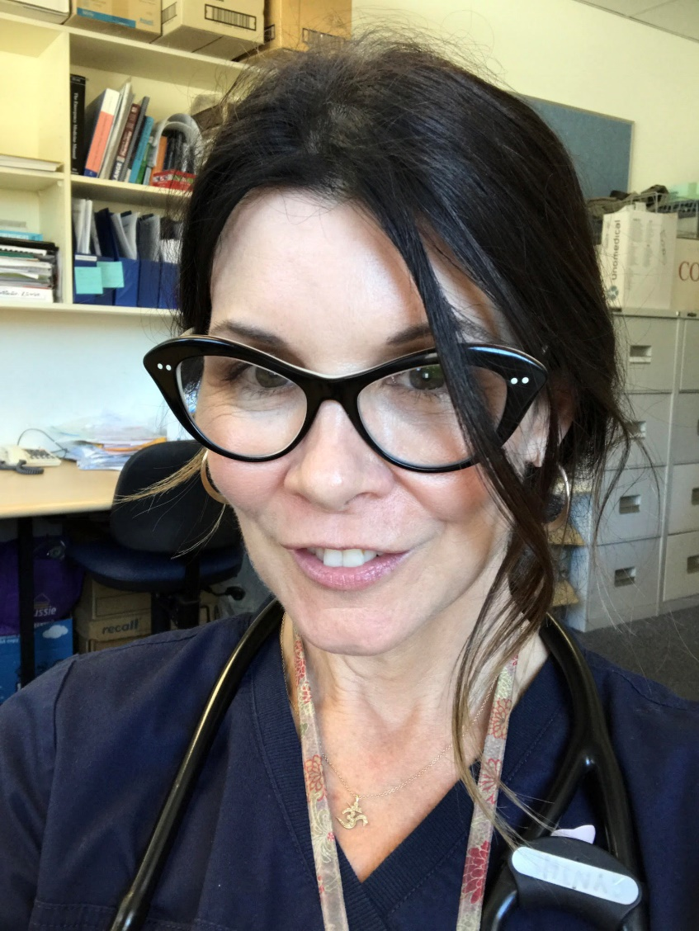
Dr Cynthia Papendick (FACEM)
Dr Cynthia Papendick is currently the Staff Specialist Emergency Department Royal Adelaide Hospital, Her Responsibilities include overseeing the care of patients in emergency department and the training of junior staff from medical students to senior registrars. Active in quality improvement initiatives including hospital avoidance for patients with chest pain; member of the resuscitation committee; Chair of the sepsis initiative aimed at improved recognition and treatment of sepsis in ED; chair of the Emergency Medicine and ED audit group; member of the South Australian Statewide Cardiology Network and the ACS management subgroup; ED representative for the nRAH Cardiology group. Principle investigator for the RAPID Tnt trial; a RCT of high sensitivity troponin being conducted at 4 hospitals in SA.

Slide 5
Doing now what patients need next

